Slide 1
Domain Deep Learning
Technology: Python
Rice Leaf Diseases Classification Using CNN With Transfer Learning
Sainath reddy Palavala

Slide 2

Index
Abstract
Introduction
Literature review
Existing Method
Drawbacks
Proposed method
Advantages
Implementation
Applications
Hardware and Software Requirements
UML diagrams
Architecture
Results
Conclusion
References

Slide 3
Abstract
Rice is one of the major cultivated crops in India which is affected by various diseases at various stages of its cultivation.
It is very difficult for the farmers to manually identify these diseases accurately with their limited knowledge.
Recent developments in Deep Learning show that Automatic Image Recognition systems using Convolutional Neural Network (CNN) models can be very beneficial in such problems.
Since rice leaf disease image dataset is not easily available, we have created our own dataset which is small in size hence we have used Transfer Learning to develop our deep learning model.
The proposed CNN architecture is based on RESNET-50 and is trained and tested on the dataset collected from rice fields and the internet.

Slide 4
Introduction
Rice is the staple source of food in India as well as across the world. It is attacked by a variety of diseases in various stages of its cultivation.
To aid the plight of the farmers and provide improved accuracy of plant disease detection, research work using various machine learning algorithms including Support Vector Machine(SVM), Artificial Neural Networks have been done.
However, the accuracy of such systems is highly dependent on feature selection techniques.

Slide 5
Recent researches on convolutional neural networks have provided great breakthrough in image based recognition by eliminating the need for image preprocessing as well as providing inbuilt feature selection.
Nowadays, mobile phones are accessible to everyone and so we have come up with the idea of an automated system where the farmers can upload the diseased leaf image and post it to our server where the neural network will be used to identify the disease and the disease classification along with the remedy can be sent back to the farmer.

Slide 6
Literature Survey
S. NO | Journal Type with year | Authors | Title | Outcomes
1 | International Journal (2018) | R. R. Atole, D. Park | A Multiclass Deep Convolutional Neural Network Classifier for Detection of Common Rice Plant Anomalies | A three-class classifier was implemented representing normal, unhealthy, and snail infested plants via transfer learning from an AlexNet deep network.
2 | Journal (2018) | P. Konstantinos Ferentinos | Deep Learning Models for Plant Disease Detection and Diagnosis | Using Deep L earning techniques detect the plant diseases.

Slide 7
S. NO | Journal Type with year | Authors | Title | Outcomes
3 | IEEE conference (2017) | Y. Lu, S. Yi,N. Zeng,Y. Liu, and Y. Zhang | Identification of Rice Diseases Using Deep Convolutional Neural Networks | we propose a deep learning methods for identification of rice diseases.
4 | Journal paper (2017) | V. Singh, A. Misra | Detection of Plant Leaf Diseases Using Image Segmentation and Soft Computing Techniques | By using Dl technique segmentation detect the plant leaf diseases.
5 | International Conference (2016) | Y. Es-saady,T. El Massi,M. El Yassa,D. Mammass, and A. Benazoun | Automatic recognition of plant leaves diseases based on serial combination of two SVM classifiers | Using SVM classifier recognize the plate diseases names.

Slide 8
Literature review
[1] R. R. Atole, D. Park, “A Multiclass Deep Convolutional Neural Network Classifier for Detection of Common Rice Plant Anomalies,” International Journal Of Advanced Computer Science And Applications,vol. 9,no. 1,pp. 67–70,2018.
This study examines the use of deep convolutional neural network in the classification of rice plants according to health status based on images of its leaves. A three-class classifier was implemented representing normal, unhealthy, and snailinfested plants via transfer learning from an AlexNet deep network. The network achieved an accuracy of 91.23%, using stochastic gradient descent with mini batch size of thirty (30) and initial learning rate of 0.0001. Six hundred (600) images of rice plants representing the classes were used in the training. The training and testing dataset-images were captured from rice fields around the district and validated by technicians in the field of agriculture.

Slide 9
[2] P. Konstantinos Ferentinos, “Deep Learning Models for Plant Disease Detection and Diagnosis,” Computers and Electronics in Agriculture ,vol. 145,pp. 311–318,2018.
In this paper, convolutional neural network models were developed to perform plant disease detection and diagnosis using simple leaves images of healthy and diseased plants, through deep learning methodologies. Training of the models was performed with the use of an open database of 87,848 images, containing 25 different plants in a set of 58 distinct classes of [plant, disease] combinations, including healthy plants.

Slide 10
[3] Y. Lu, S. Yi,N. Zeng,Y. Liu, and Y. Zhang, “Identification of Rice Diseases Using Deep Convolutional Neural Networks,” Neurocomputing, 267, pp. 378-384,2017.
An accurate and timely detection of diseases and pests in rice plants can help to reduce economic losses substantially. It can help farmers in applying timely treatment. Recent developments in deep learning based convolutional neural networks (CNN) have allowed researchers to greatly improve the accuracy of image classification. In this paper, we present a deep learning based approach to detect diseases and pests in rice plants using images captured in real life scenerio with heterogeneous background.

Slide 11
[4] V. Singh, A. Misra, “Detection of Plant Leaf Diseases Using Image Segmentation and Soft Computing Techniques,” Information Processing in Agriculture,vol. 4 ,no. 1,pp. 41–49,2017
Agricultural productivity is something on which economy highly depends. This is the one of the reasons that disease detection in plants plays an important role in agriculture field, as having disease in plants are quite natural. If proper care is not taken in this area then it causes serious effects on plants and due to which respective product quality, quantity or productivity is affected. For instance a disease named little leaf disease is a hazardous disease found in pine trees in United States.

Slide 12
[5] Y. Es-saady,T. El Massi,M. El Yassa,D. Mammass, and A. Benazoun, ”Automatic recognition of plant leaves diseases based on serial combination of two SVM classifiers,” International Conference on Electrical and Information Technologies (ICEIT) pp. 561-566, 2016.
This paper presents a machine vision system for automatic recognition of plant leaves diseases from images. The proposed system is based on serial combination technique of two SVM classifiers. The first classifier uses the color to classify the images; it considers, at this phase, that the diseases with similar or nearest color belonging to the same class. Then, the second classifier is used to differentiate between the classes with similar color according to the shape and texture features.

Slide 13
Existing method
In existing systems, it is very difficult for the farmers to manually identify many diseases accurately with their limited knowledge. This difficulty can be overcome by using deep learning techniques.
Earlier works involves using older Machine Learning algorithms like Support Vector Machine(SVM),Artificial Neural Networks.
They suffer from very low accuracies.
This uses neural networks for prediction but they have high complexities and they fail to individually identify the important features for prediction.
In previous cases most of them used machine learning algorithms,they faced lots of errors in decision making and analyzing.

Slide 14
Disadvantages
It is difficult to detect and identify diseases.
Difficult to handle.
It takes more time.
Difficult to scale up.
Time consuming.

Slide 15
Proposed system
In proposed system, we propose a Deep Learning technologies that automatically recognizes images using Convolution Neural Network (CNN) models can be very beneficial in such problems. By using these techniques we can easily detect and identify the diseases.
Exploring Deep learning Algorithms for rice leaf detection.
Validating and training the data set.
Test and compare the accuracy of base models with real-time implementation(transfer learning).
Implementing framework using python and taking riceleaf data set as input and classify this as Leaf Blast,Leaf Blight,Brown Spot and healthy.

Slide 16
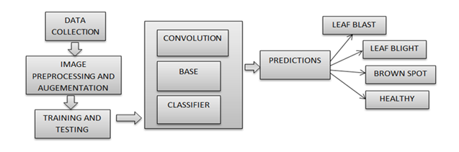
Advantages Proposed Method

Slide 17
Advantages
It takes less time to identify and detect the disease.
Results are accurate.
Easy to handle.

Slide 18
Implementation
1. System
1.1 Create Dataset:
The dataset containing images of the desired objects to be recognize is split into training and testing dataset with the test size of 20-30%.
1.2 Pre-processing:
Resizing and reshaping the images into appropriate format to train our model. 1.3Training:
Use the pre-processed training dataset is used to train our model using CNN algorithm.

Slide 19
2.User:
2.1 Register
The user needs to register and the data stored in MySQL database.
2.2 Login
A registered user can login using the valid credentials to the website to use a application.
2.3 About-Project
In this application, we have successfully created an application which takes to classify the images.

Slide 20
2.4 Upload Image
The user has to upload an image which needs to be classify the images.
2.5 Prediction
The results of our model is displayed as either Rice Blast, Leaf Blight, Healthy & Brown Spot.
2.6 Logout
Once the prediction is over, the user can logout of the application.

Slide 21
r:
APPLICATIONS:
Agriculture sectors can implement this application for better harvest.
Scientific researches.

Slide 22
Hardware and Software Requirements:
H/W Configuration:
Processor - I3/Intel Processor
Hard Disk -160GB
Key Board - Standard Windows Keyboard
Mouse - Two or Three Button Mouse
Monitor - SVGA
RAM - 8Gb

Slide 23
S/W Configuration:
S/W Configuration:
Operating System : Windows 7/8/10
Server side Script : HTML, CSS & JS
IDE : Pycharm
Libraries Used : Numpy, IO, OS, Pillow, keras,
Technology : Python 3.6+

Slide 24
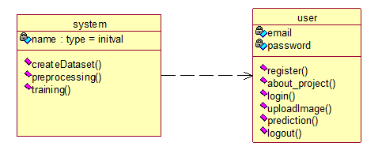
UML diagrams
CLASS DIAGRAM:
In software engineering, a class diagram in the Unified Modeling Language (UML) is a type of static structure diagram that describes the structure of a system by showing the system's classes, their attributes, operations (or methods), and the relationships among the classes. It explains which class contains information.

Slide 25
USE CASE DIAGRAM:
A use case diagram in the Unified Modeling Language (UML) is a type of behavioral diagram defined by and created from a Use-case analysis. Its purpose is to present a graphical overview of the functionality provided by a system in terms of actors, their goals (represented as use cases), and any dependencies between those use cases.

Slide 26
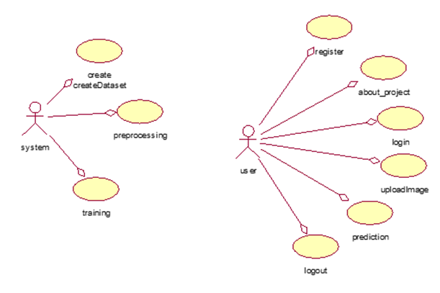

Slide 27
SEQUENCE DIAGRAM:
A sequence diagram in Unified Modeling Language (UML) is a kind of interaction diagram that shows how processes operate with one another and in what order. It is a construct of a Message Sequence Chart. Sequence diagrams are sometimes called event diagrams, event scenarios, and timing diagrams.

Slide 28
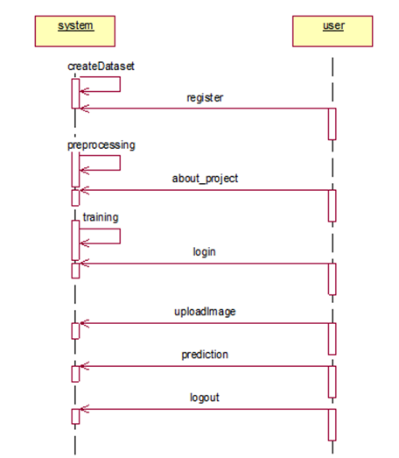

Slide 29
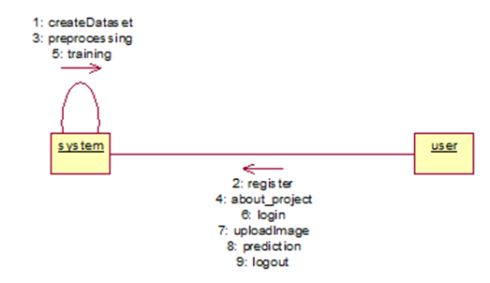
Collaboration Diagram:
In collaboration diagram the method call sequence is indicated by some numbering technique as shown below. The number indicates how the methods are called one after another. We have taken the same order management system to describe the collaboration diagram. The method calls are similar to that of a sequence diagram. But the difference is that the sequence diagram does not describe the object organization whereas the collaboration diagram shows the object organization.

Slide 30
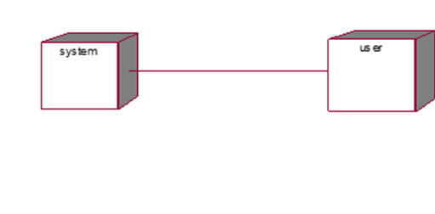
DEPLOYMENT DIAGRAM
Deployment diagram represents the deployment view of a system. It is related to the component diagram. Because the components are deployed using the deployment diagrams. A deployment diagram consists of nodes. Nodes are nothing but physical hardware’s used to deploy the application.

Slide 31
ACTIVITY DIAGRAM:
Activity diagrams are graphical representations of workflows of stepwise activities and actions with support for choice, iteration and concurrency. In the Unified Modelling Language, activity diagrams can be used to describe the business and operational step-by-step workflows of components in a system. An activity diagram shows the overall flow of control.

Slide 32
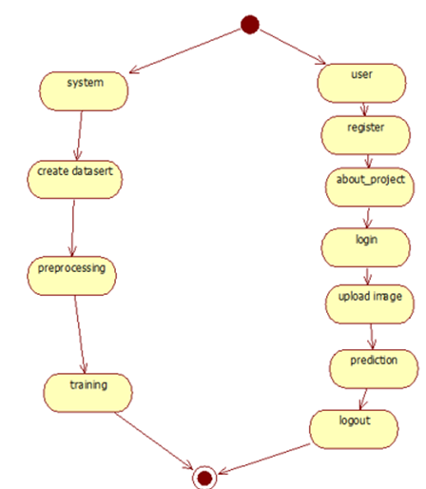

Slide 33
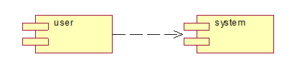
Component diagram,
A component diagram, also known as a UML component diagram, describes the organization and wiring of the physical components in a system. Component diagrams are often drawn to help model implementation details and double-check that every aspect of the system's required functions is covered by planned development.

Slide 34
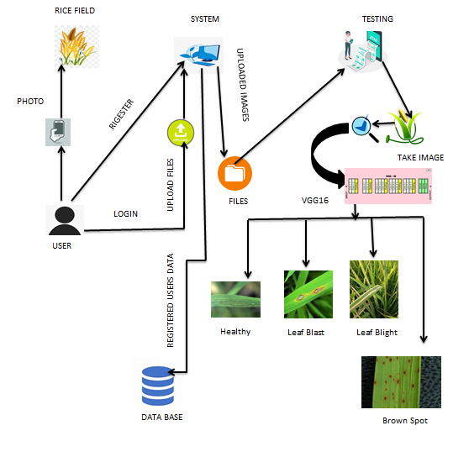
Architecture

Slide 35

Results(Input)
Home page:

Slide 36
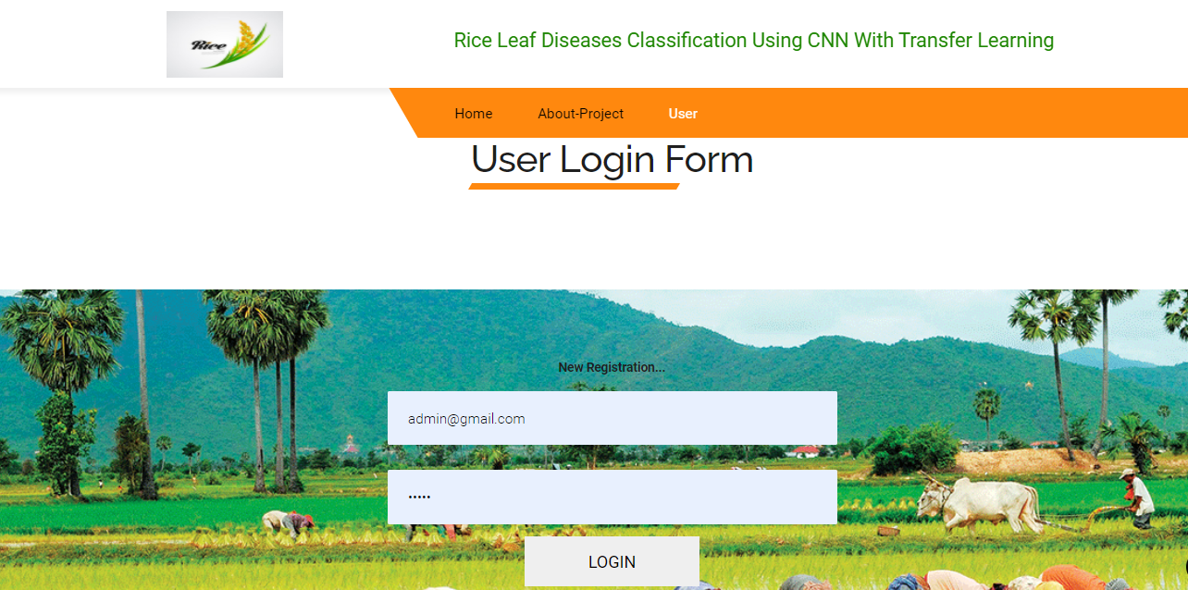
User Login Page:

Slide 37
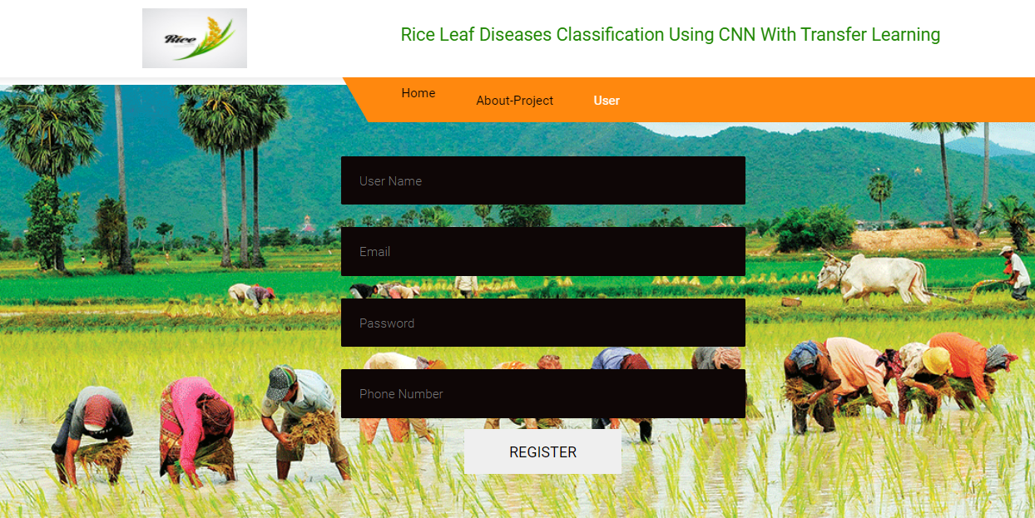
User Registration Page:

Slide 38
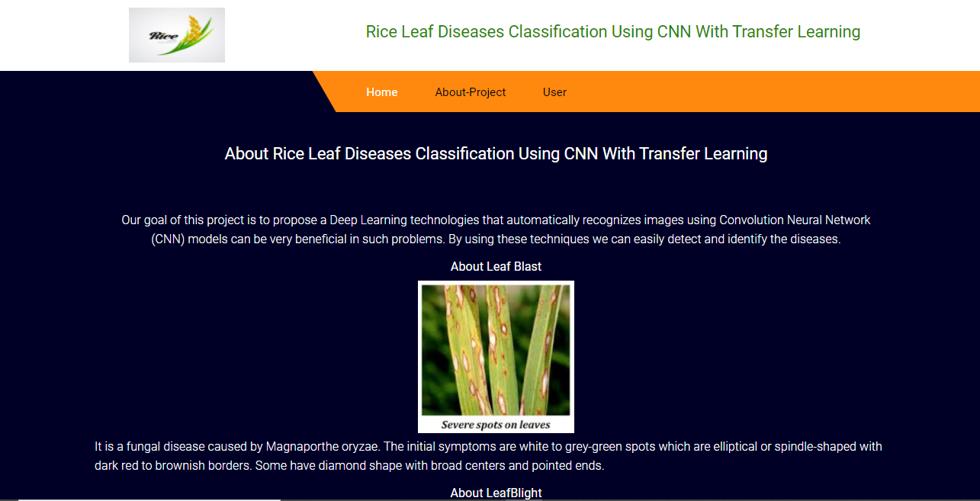
ABOUT THE PROJECT:

Slide 39

User Home Page:

Slide 40
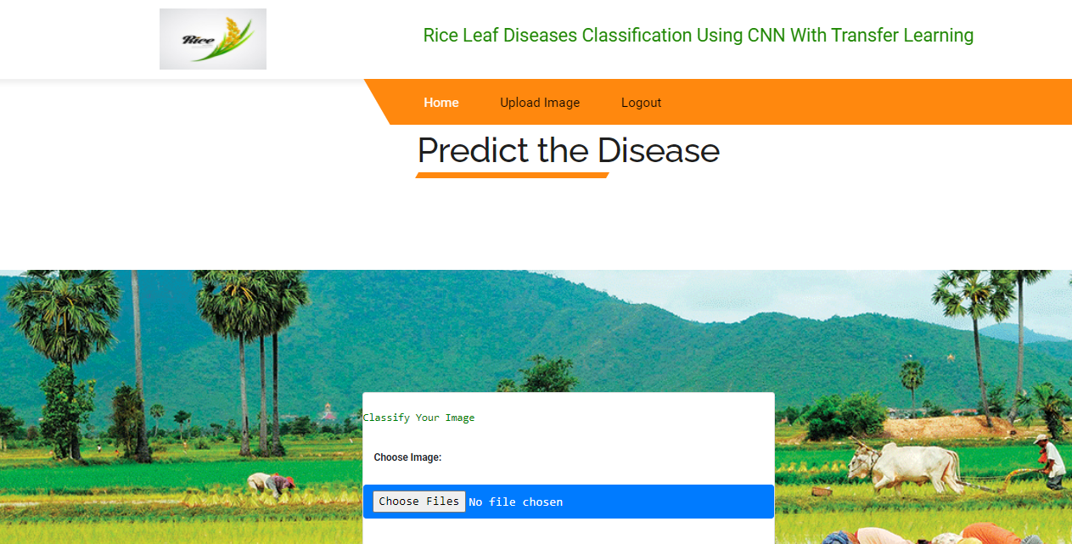
Upload an image

Slide 41
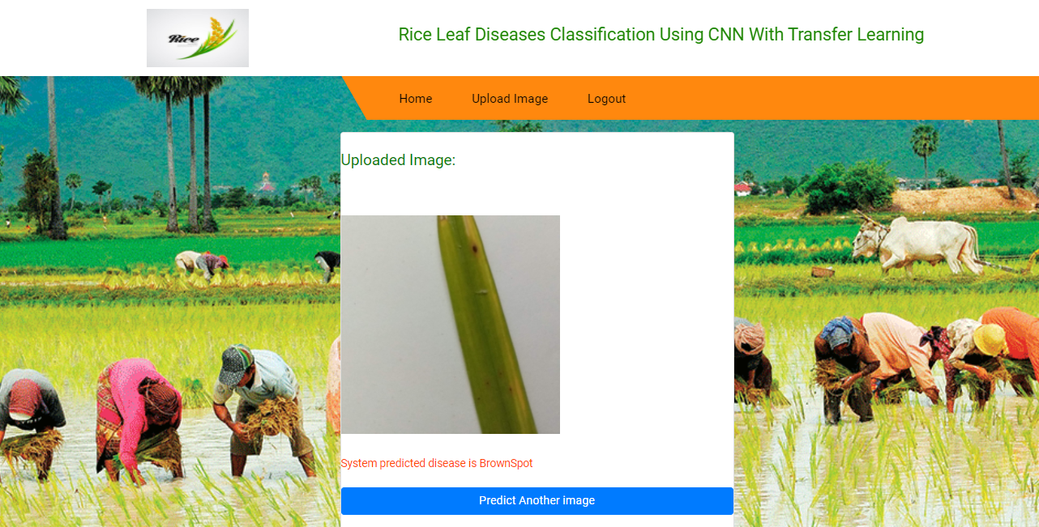
System predicted disease is BownSpot:

Slide 42
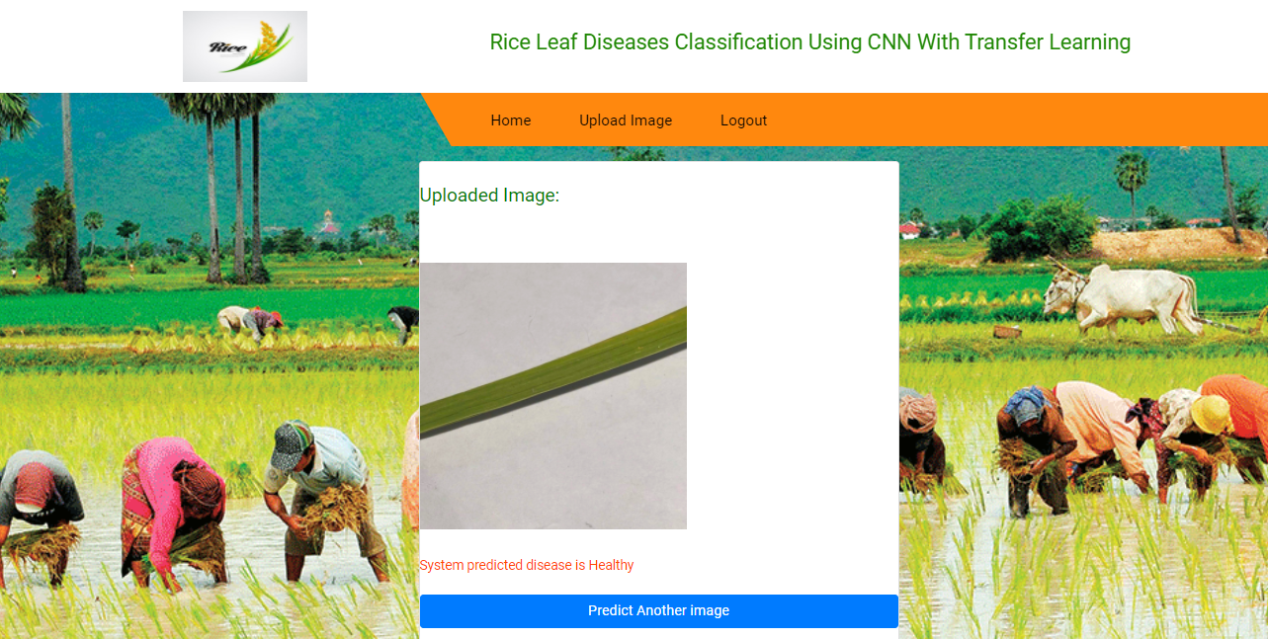
System predicted disease is Healthy:

Slide 43
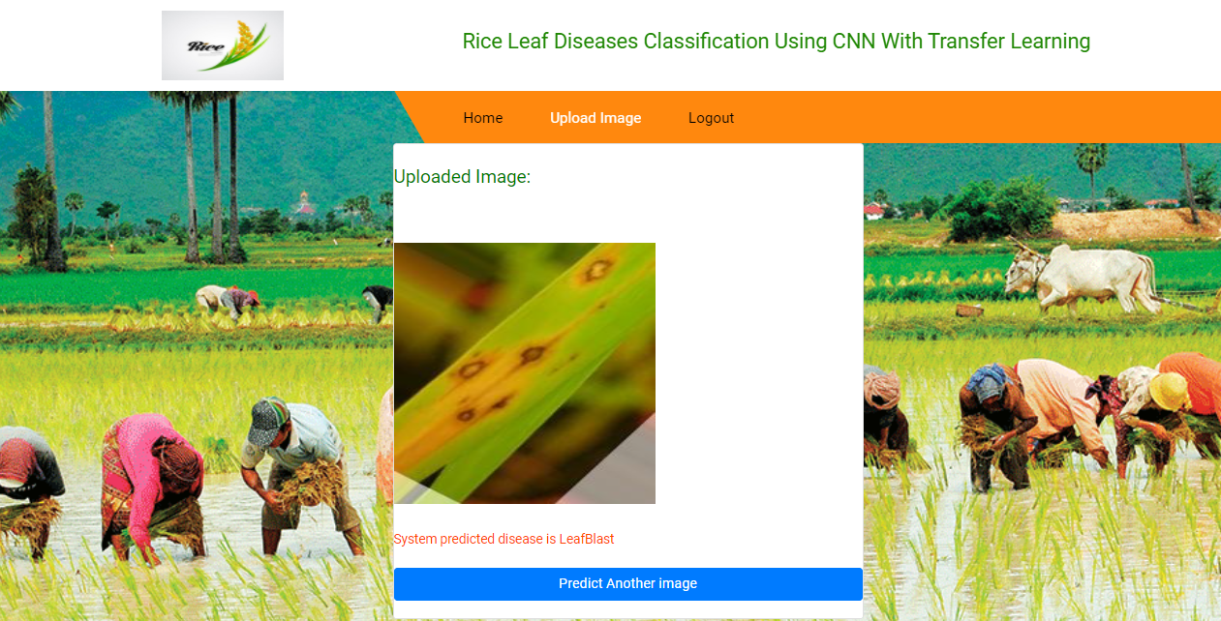
System predicted disease is LeafBlast:

Slide 44
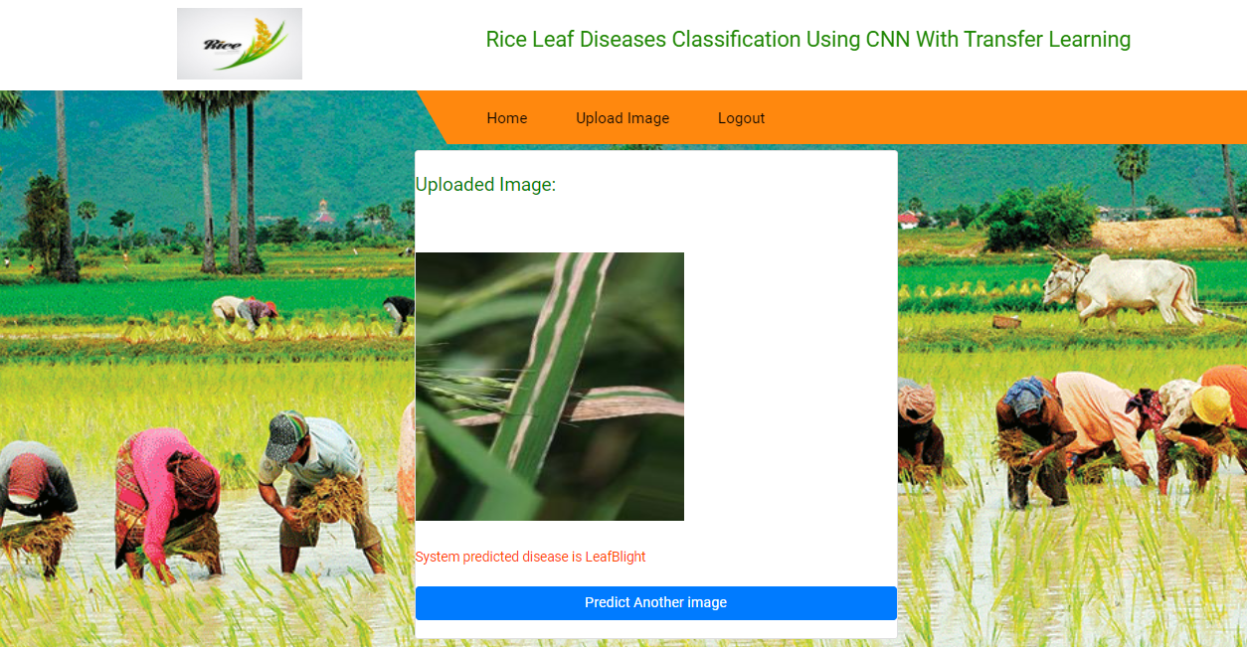
System predicted disease is LeafBlight:

Slide 45
Conclusion:
In this paper we have proposed a deep learning architecture with training on 1509 images of rice leaves and testing on different 647 images and that correctly classifies 92.46% of the test images. Transfer Learning using fine-tuning the predefined RESNET-50 has greatly improved the performance of the model which otherwise did not produce satisfactory results on such small dataset. The number of epochs used was stopped at 25 because we had received a cut point after which the accuracy was not improving and the loss was not decreasing on both training and validation data.

Slide 46
References:
[1] T. Gupta, ”Plant leaf disease analysis using image processing technique with modified SVM-CS classifier,” Int. J. Eng. Manag. Technol, no. 5, pp. 11-17, 2017.
[2] Y. Es-saady,T. El Massi,M. El Yassa,D. Mammass, and A. Benazoun, ”Automatic recognition of plant leaves diseases based on serial combination of two SVM classifiers,” International Conference on Electrical and Information Technologies (ICEIT) pp. 561-566, 2016.
[3] P. B. Padol and A. A. Yadav, “SVM classifier based grape leaf disease detection,” Conference on Advances in Signal Processing (CASP), pp. 175-179, 2016.

Slide 47
[4] L. Liu and G. Zhou, “Extraction of the rice leaf disease image based on BP neural network,” International Conference on Computational Intelligence and Software Engineering ,pp. 1-3,2009.
[5] S. Arivazhagan and S.V. Ligi, “Mango Leaf Diseases Identification Using Convolutional Neural Network,” International Journal of Pure and Applied Mathematics, vol. 120,no. 6, pp. 11067-11079,2008.

Slide 48


